Slide 1
Thu Tran
Chemical Engineer - Data Scientist

Slide 2
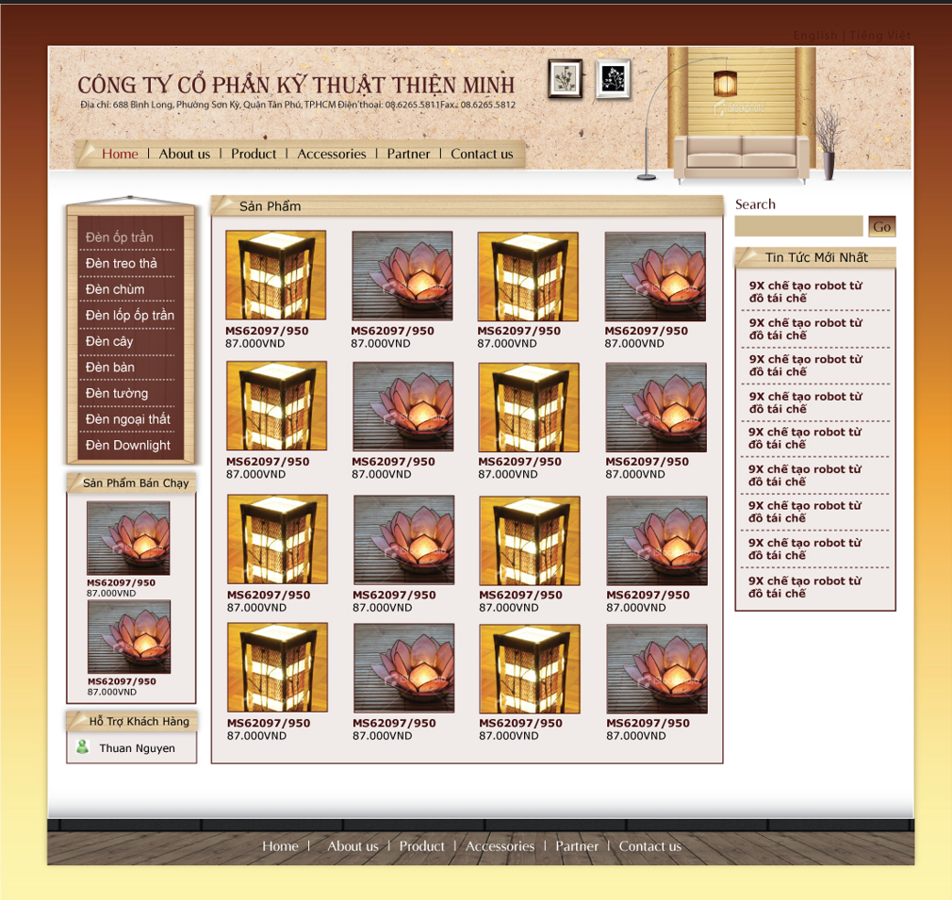
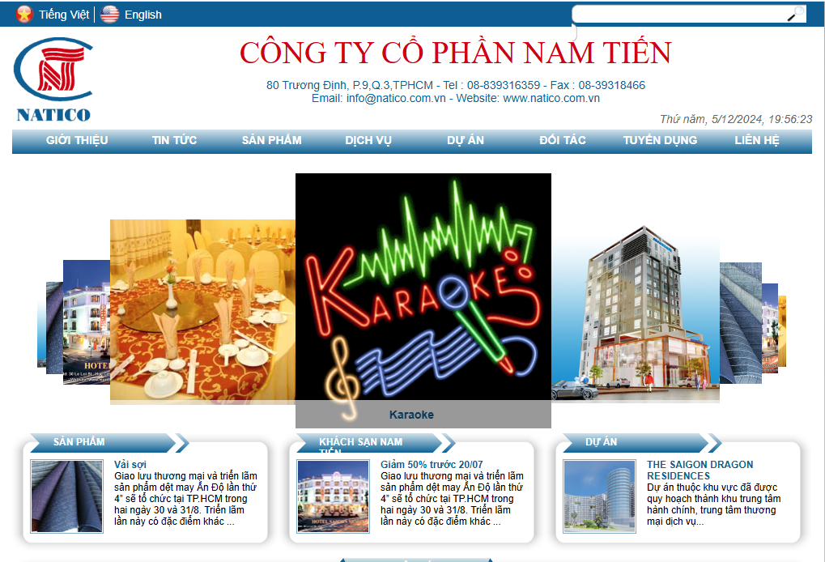
Senior User Interface Developer
Vinasource : Jan 2008 – Nov 2011
Proficient in HTML, CSS, JavaScript, with experience in PHP and ASP.NET.
Led team development efforts to ensure successful project delivery.
Provided technical leadership through coaching, mentorship, and peer code reviews.
Designed, developed, and unit tested applications according to industry standards.
Enhanced teamwork and leadership skills through task management and collaboration.

Slide 3


Senior User Interface Developer
GNT : Nov 2011 – Dec 2012
Proficient in HTML, CSS, JavaScript, C#, C++, ASP.NET, and PHP
Developed web commercial applications.
Created metadata collection for integration with Google Analytics.
Managed multiple collaborative projects and systems.
Strong interpersonal, oral, and written communication skills

Slide 4
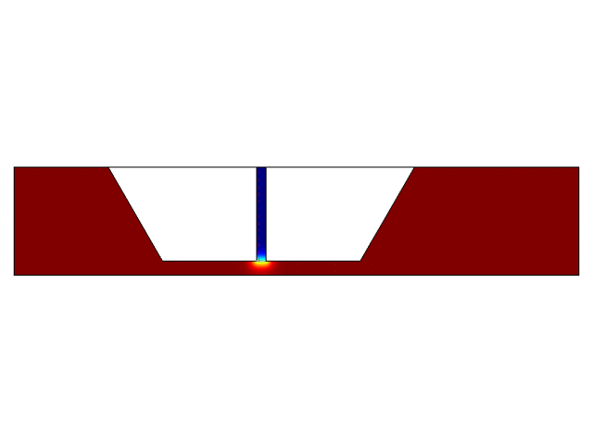
Multiphysics Simulation Engineer
Drexel ChE Dept: Mar 2020 – Sep 2020
Assisted in developing COMSOL simulations for a die-slot coating machine.
Optimized 2D/3D models through data analysis and root cause problem analysis.
Analyzed Computational Fluid Dynamics (CFD) to enhance model performance.
Developed statistical tools for team performance improvement.

Slide 5
Industrial Process Engineer / Data Engineer
Coherence, DE: June 2021 – Feb 2022
Identified root causes, implemented corrective actions, and verified process specifications.
Developed systems for maintenance, calibration, and dimensional control.
Built inventory and tracking systems for monitoring deliveries and non-conforming products.
Analyzed supply levels to improve inventory management and anticipate potential issues.
Developed statistical tools and optimized data sets for performance monitoring and analysis.
Power Query
VBA
Access Database
SQL
Data connection

Slide 6
Process Improvement Engineer / Data Visualization Engineer
IVC - Philadelphia, PA: Feb 2022 – June 2023
Led Gemba walks / meeting
Created DoE to prioritize and streamline improvement efforts.
Improved OEE by optimizing changeover processes.
Conducted cost analysis and scaled batch sizes from R&D to pilot plants.
Gained hands-on experience with biopharma equipment and cGMP processes.
Created DOE and process maps for better system reliability.
Applied ETL techniques to ensure data accuracy in MES, Oracle, and Power BI.
Used data mining to create monitoring datasets for data-driven decisions.
Developed statistical models and algorithms for process optimization.
Created real-time process algorithms to improve machine run times.
Built data visualization applications using Power BI and verified SIT.

Slide 7
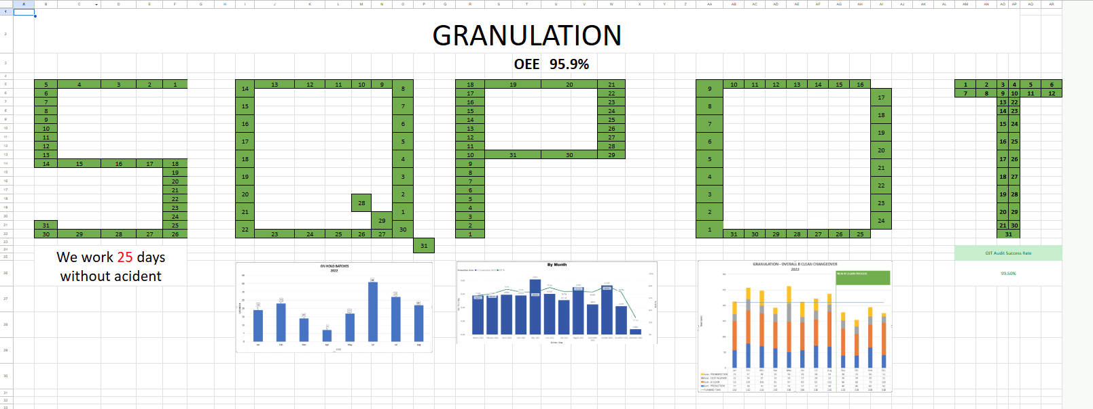
Gemba Digital Dashboard

Slide 8
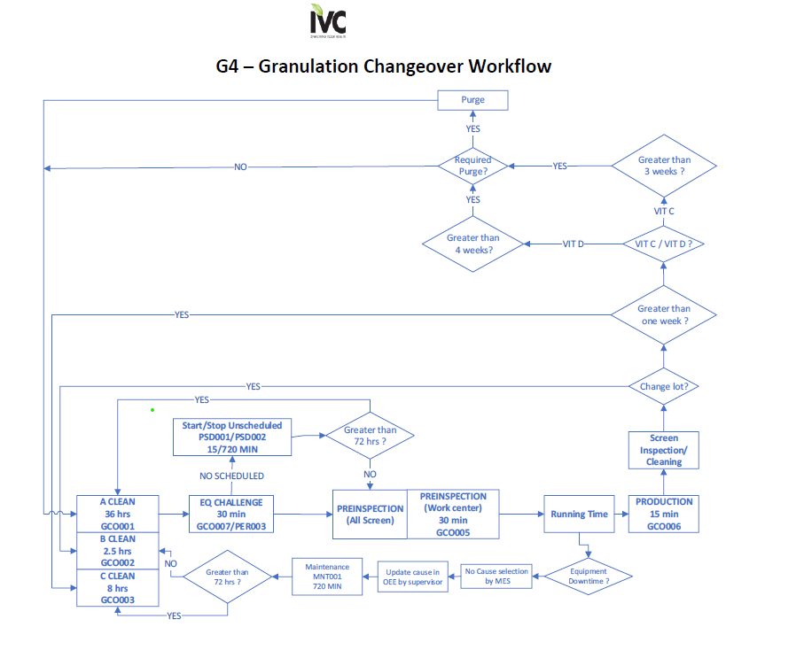
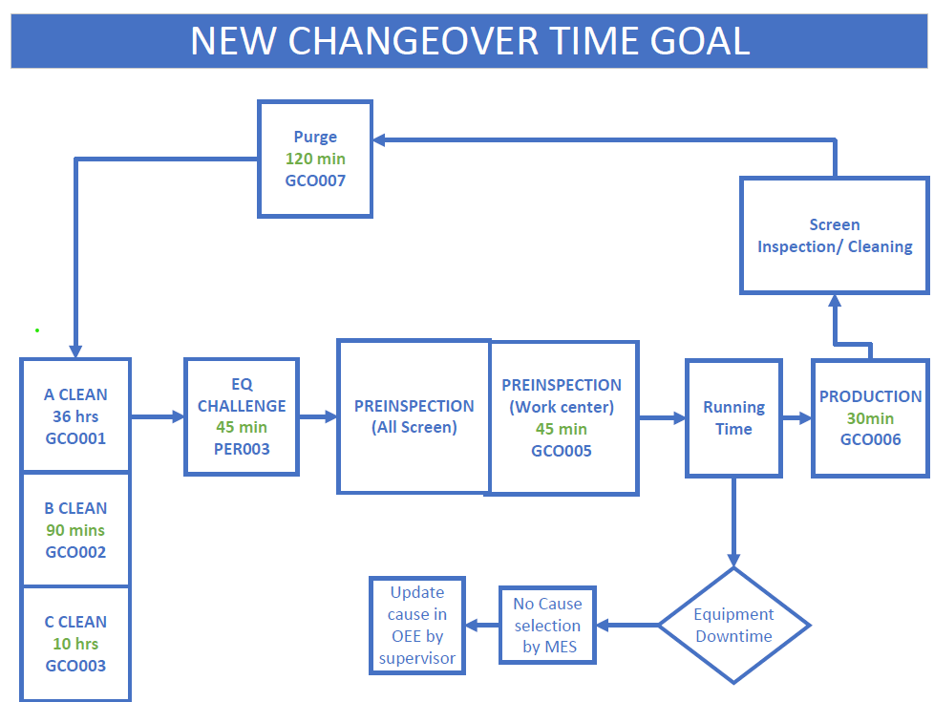
Granulation Changeover Workflow

Slide 9
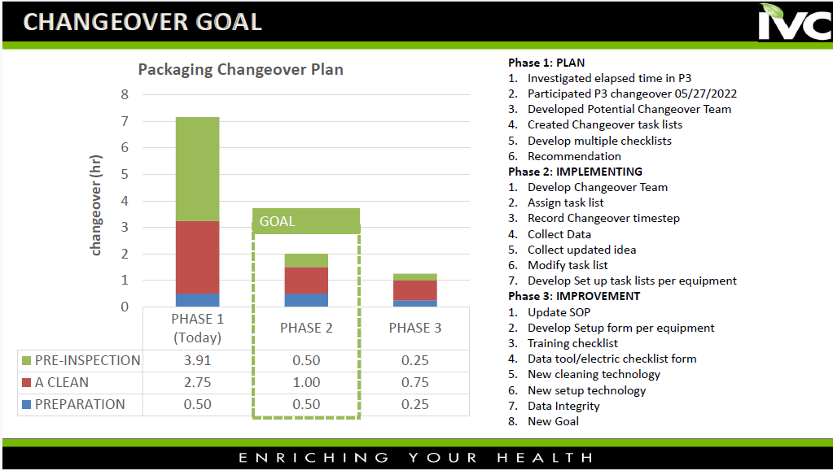
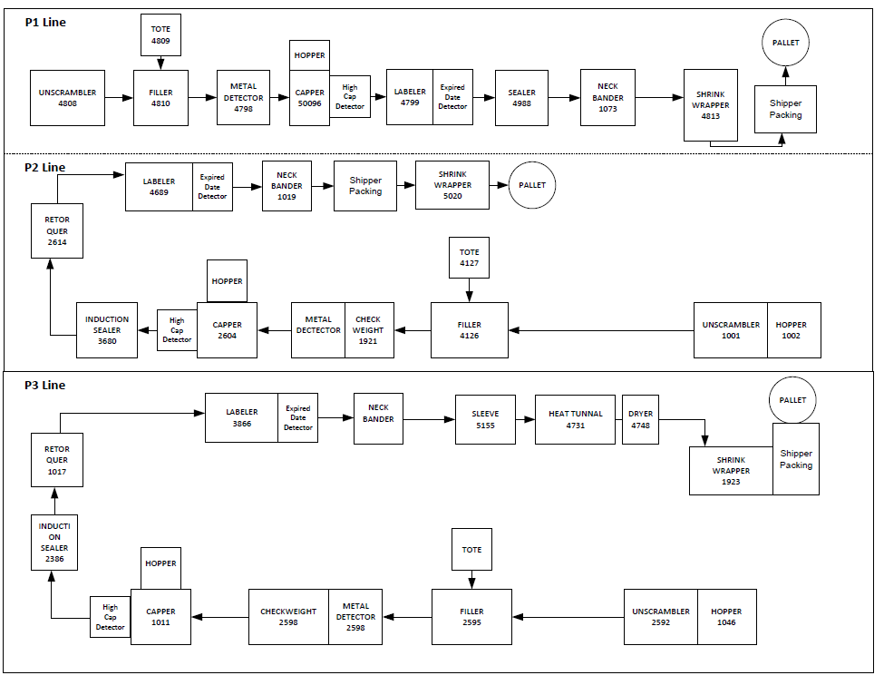
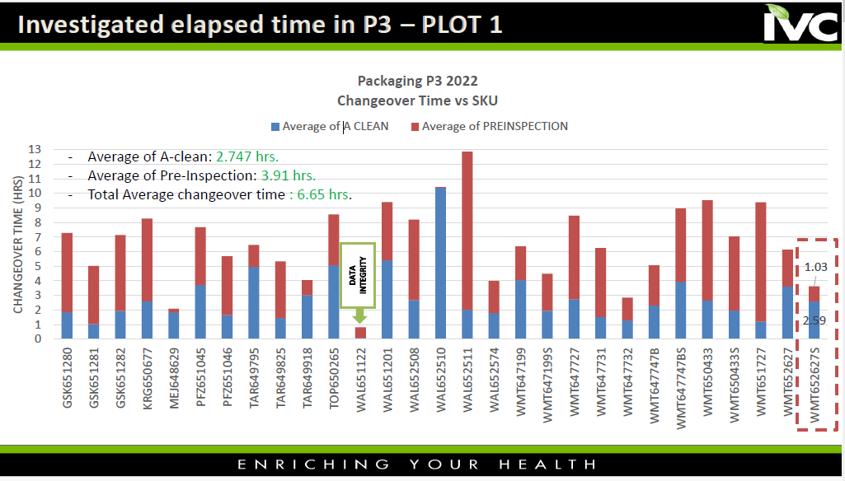
Packaging Changeover Plan

Slide 10
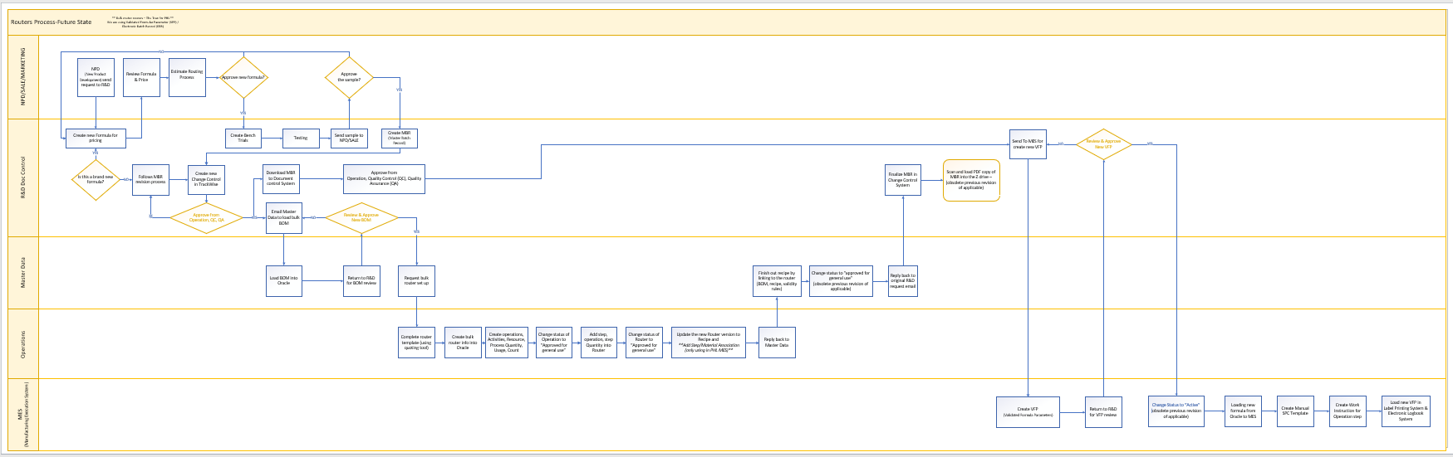
New Product Process

Slide 11
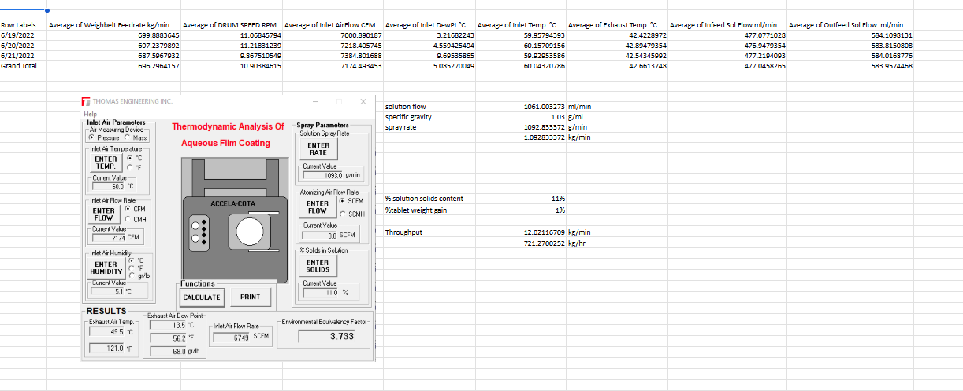
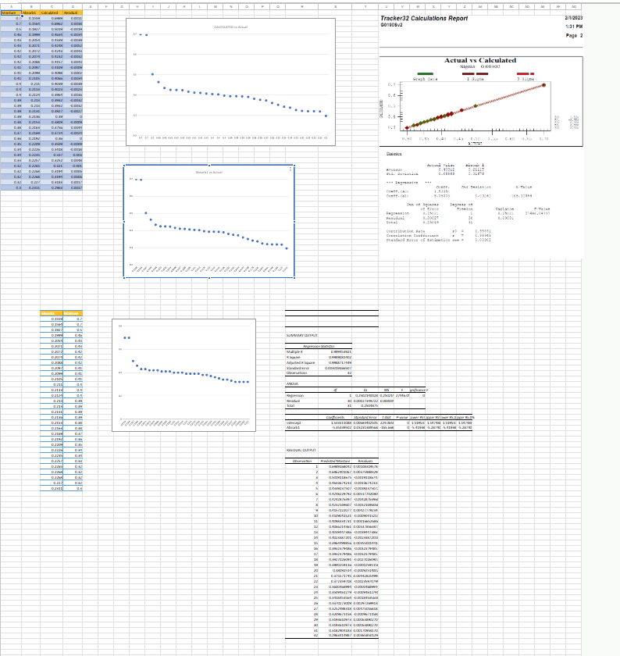
DOE for Equipment Reliability
Moisture Probe Ca
Coating Parameter Control

Slide 12
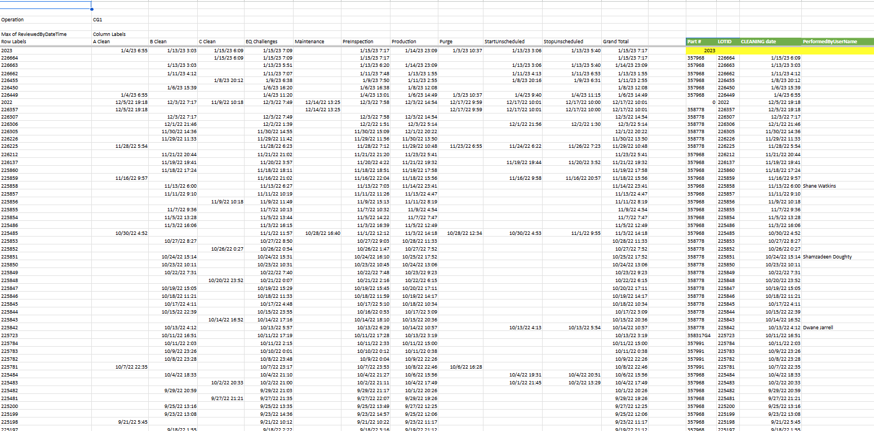
Extract, Transform, and Load Data

Slide 13
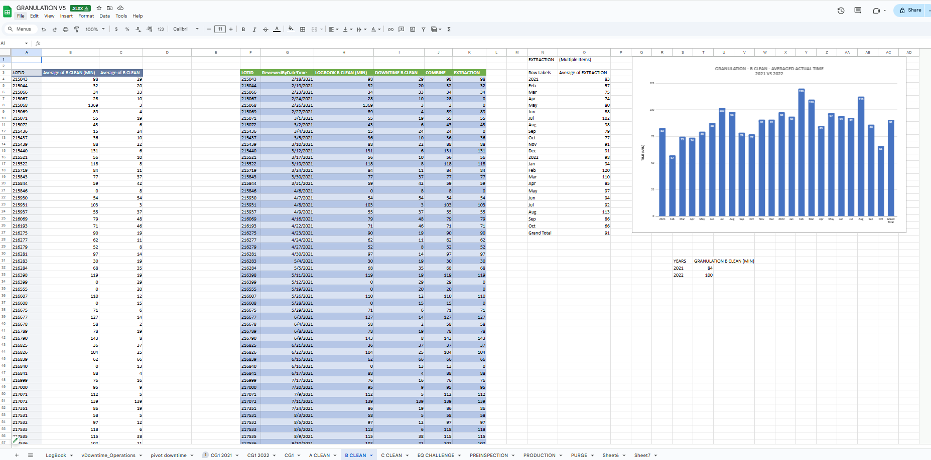
Statistic Model in Real-time data

Slide 14
Senior Manufacture Technology Engineer / Data Scientist
Dupont – Newark, DE: Oct 2023 – Currently
Led Process Hazard Analysis (PHA) meetings.
Directed Audit meetings.
Developed and delivered Trade Secret Training.
Managed yield improvement projects.
Led capital projects for Particle Size Distribution (PSD) specifications.
Analyzed and reduced material loss in processes.
Implemented barcode systems for OPEX projects.
Collaborated with cross-functional teams to develop Power BI dashboards.
Designed and implemented Power BI dashboards for yield and scrap analysis.
Created a quality data warehouse to enhance data accessibility for sister sites.
Developed applications to support operational digitalization transitions.
Designed and implemented AI-assisted solutions for manufacturing processes.

Slide 15
Thu Tran
Master of Science in Data Science
2023 - 2024

Slide 16
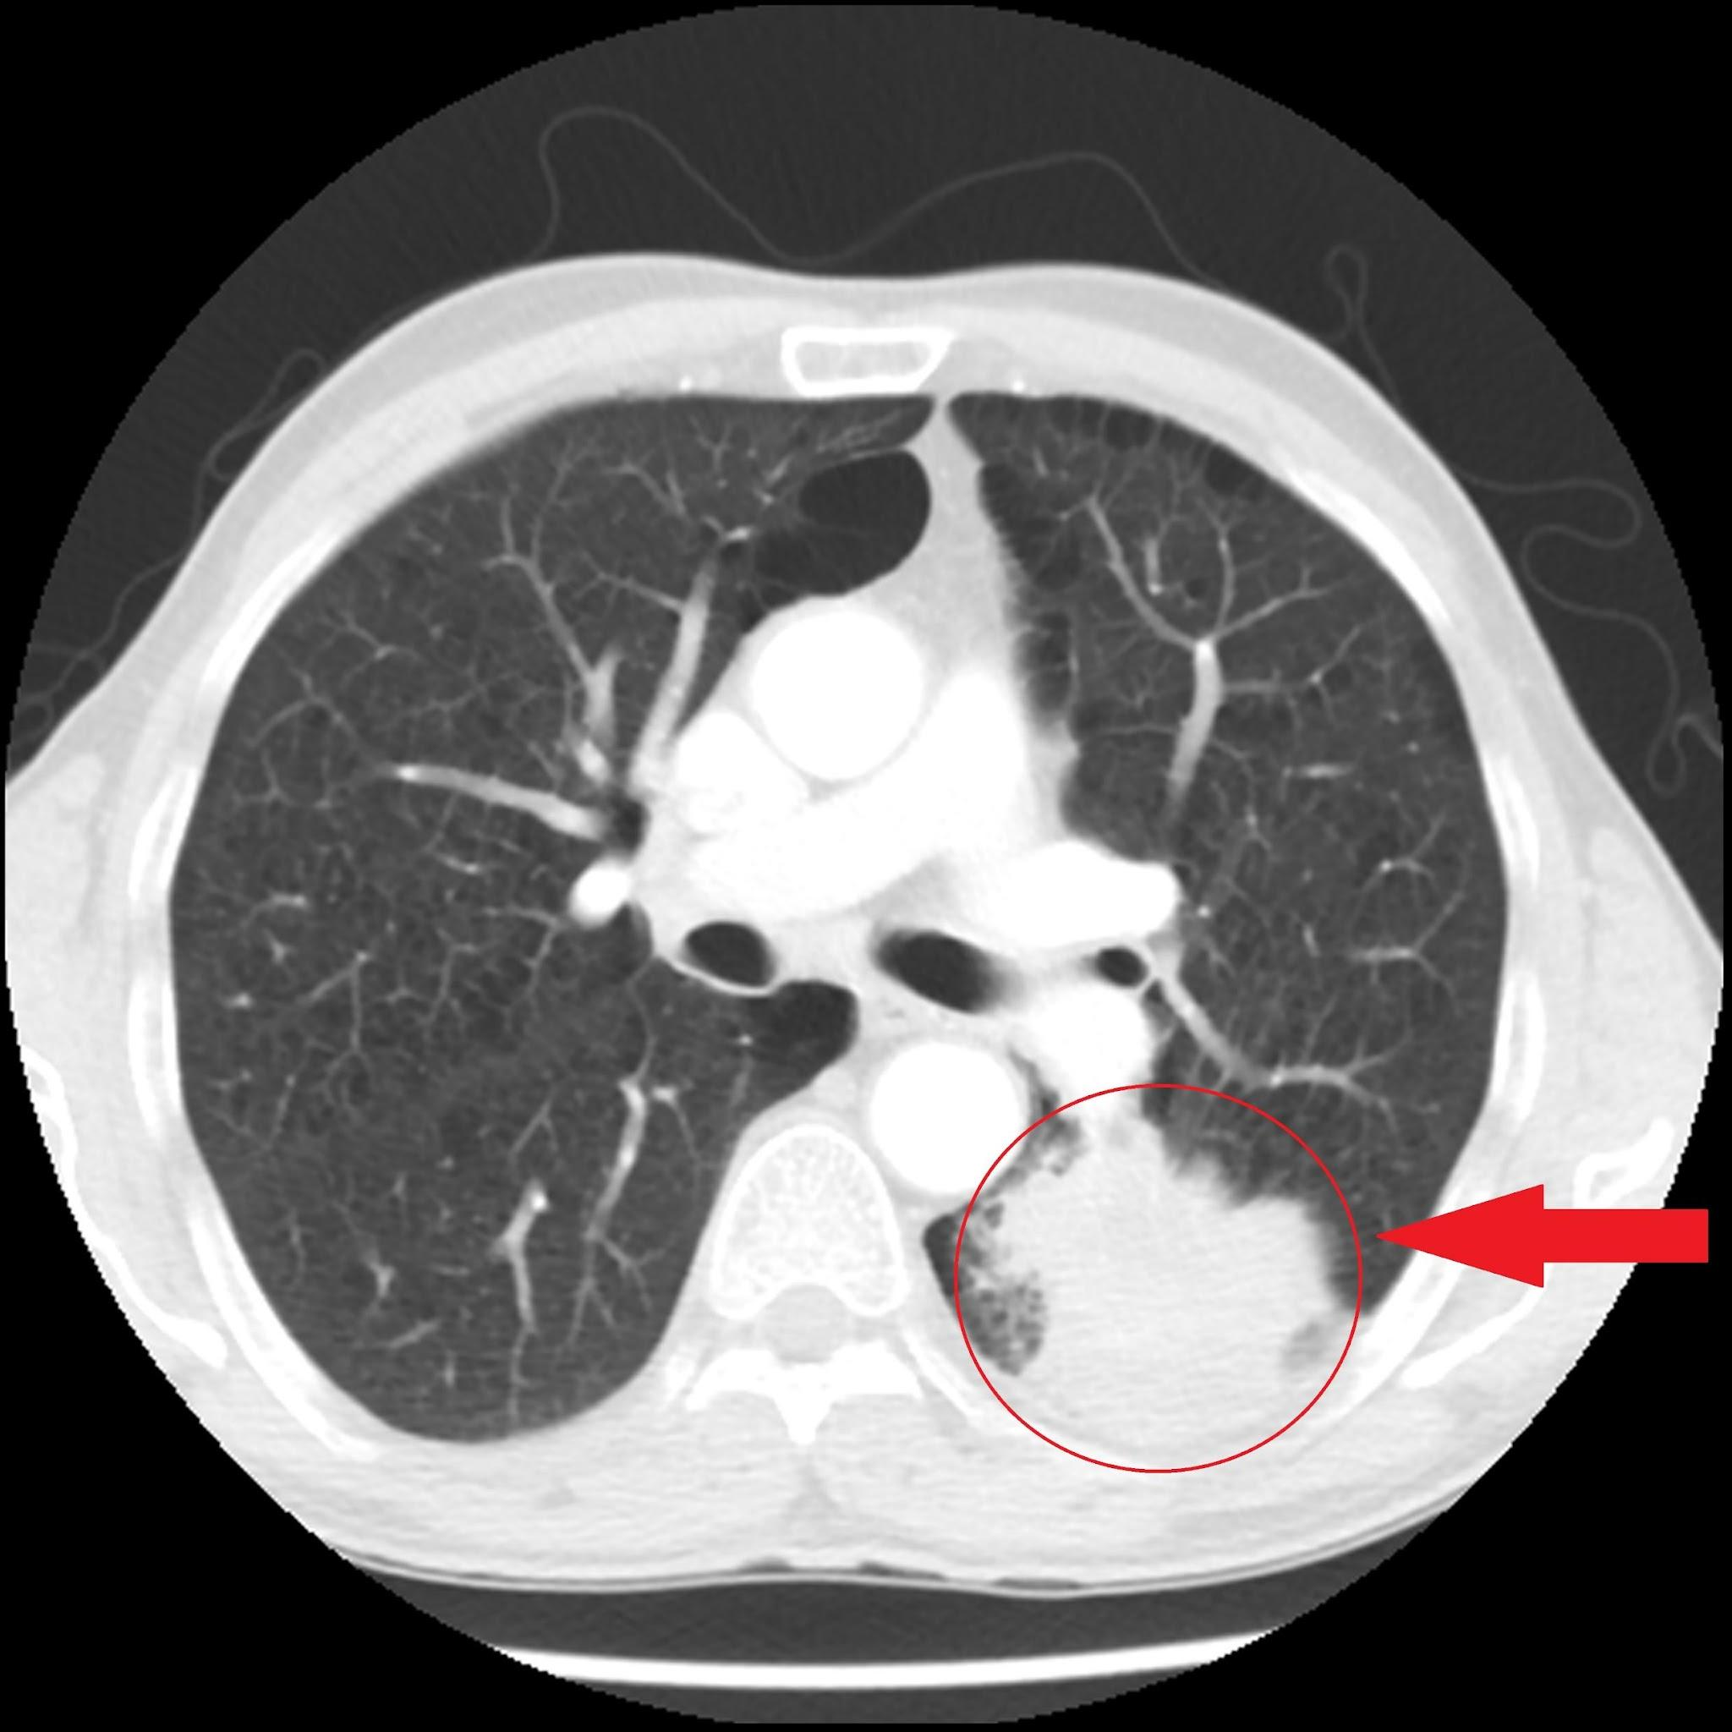
Introduction
Lung cancer caused 1 in 5 U.S. cancer deaths in 2024; 5 years survival was only 28% in 2016
CT scans are key for lung cancer diagnosis but prone to errors and delay due to manual interpretation
A machine learning toolset was developed to improve detection accuracy and efficiency
Global institution use AI for precision medicine, cell segmentation, and disease prediction
This study refines prior methods and applies them to external validation dataset

Slide 17
Research Objectives
Build a machine learning model(s) for accurate diagnosis of lung cancer from CT scans
Compare the effects of image segmentation and feature extraction on model(s) performance and benchmark against automated feature extraction in deep learning model(s)
Determine and visualize pixels/features highly impacting model(s) classification
Assess the effectiveness of model(s) performance in an external validation setting
Data Sources
IQ-OTH/NCCD Dataset: Contains 110 cases from 2019 with 1102 JPG images categorized as Malignant, Benign, and Normal, available under the CC0 1.0 license.
DLCT Lung Detect Net: A validation dataset featuring 1000 images in JPG and PNG formats categorized for various lung tumors, also under the CC0 1.0 license.

Slide 18
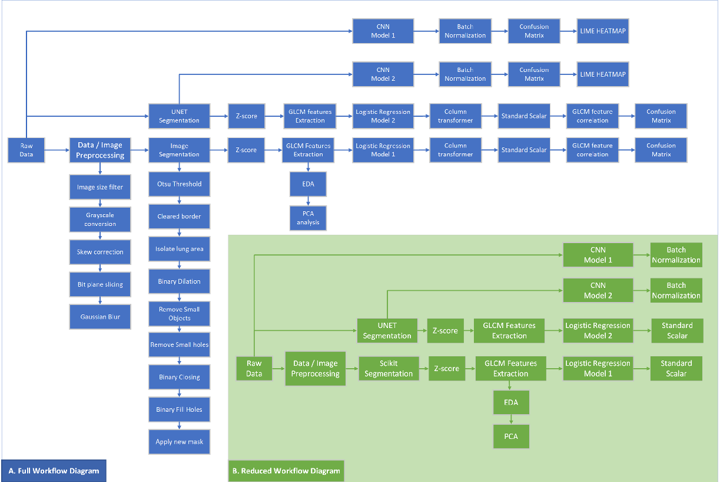
Workflow

Slide 19
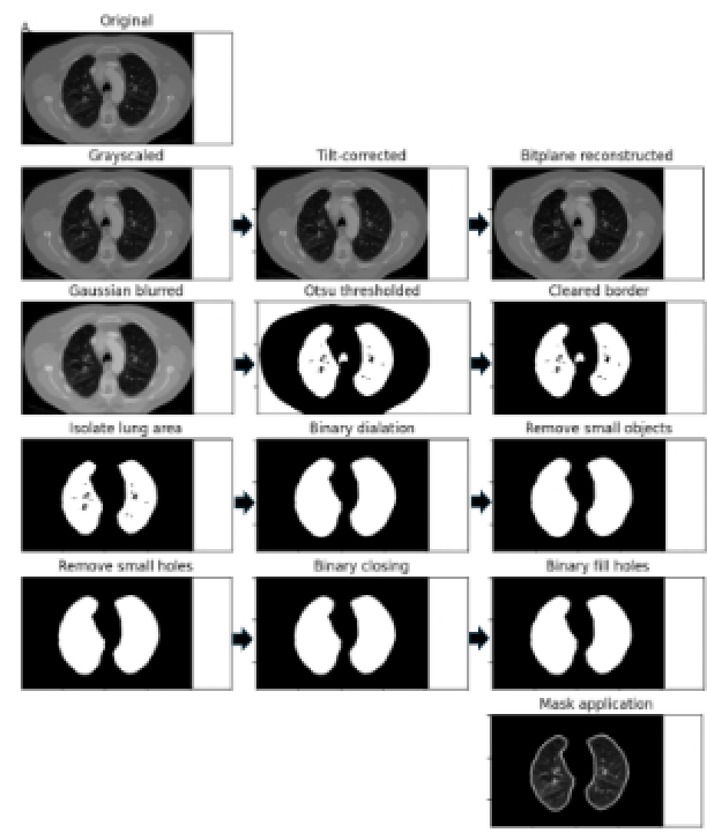
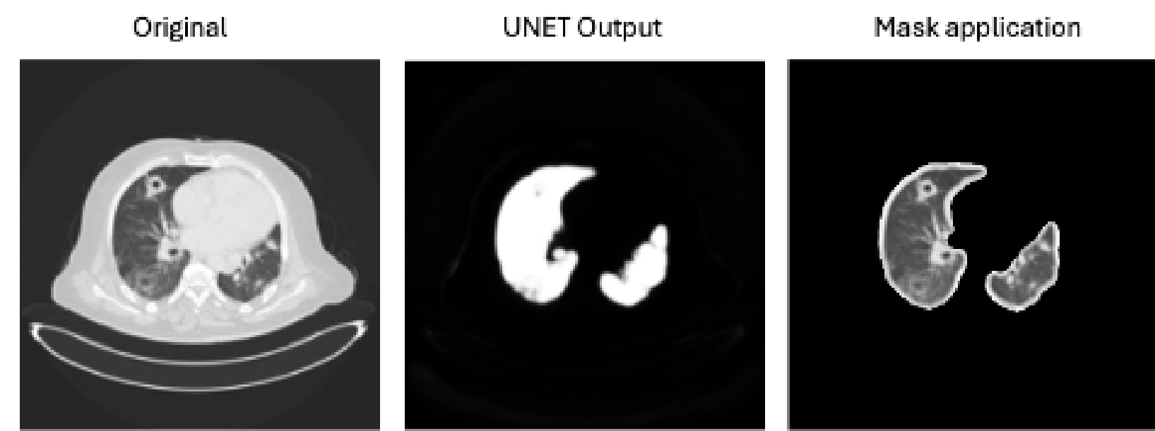
Image Segmentation
Scikit segmentation
Unet segmentation

Slide 20
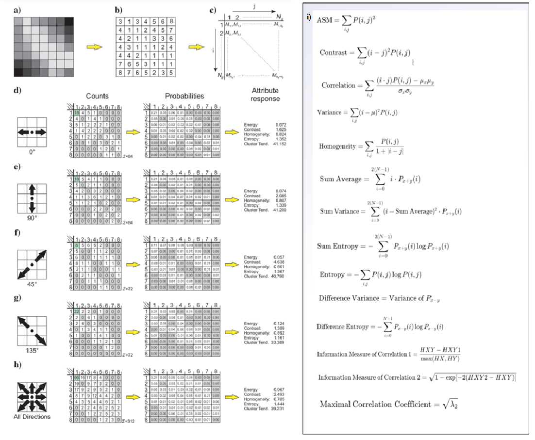
Feature Extraction

Slide 21

EDA

Slide 22
Logistic Regression Model
Segmentation Approaches:
First approach: Used skimage morphology for pre-processing and segmentation.
Second approach: Utilized a trained UNET model for pre-processing and segmentation.
Logistic Regression Model Steps:
Replaced masked scan areas with NA.
Individually z-scored image arrays.
Extracted GLCM texture features from remaining values.
Split data into 70% training and 30% testing sets.
Standardized features using sklearn Standard Scaling.
Optimized model penalty via grid search (C parameter of 10).
Trained logistic regression model with l1 penalty.
Evaluated model on test and validation sets for accuracy and metrics.
Model Performance:
Logistic Regression 1 (Scikit images): 81% weighted F1 score (test), 80% (validation).
Logistic Regression 2 (UNET images): 62% weighted F1 score (test), 59% (validation).

Slide 23
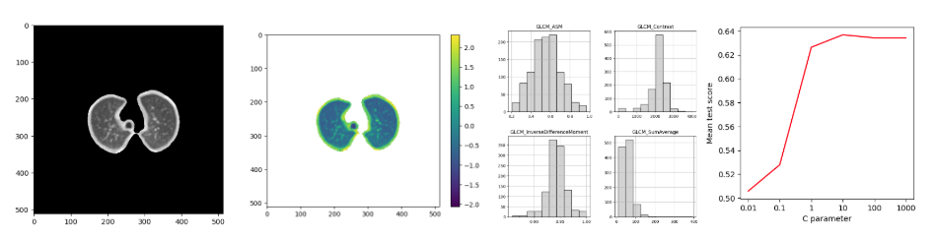
Logistic Regression Model

Slide 24
CNN Model
Image Pre-processing: Created directories two datasets
CNN Model Steps:
Created a data frame with relevant metadata.
Removed inconsistent image dimension rows.
Loaded, resized, normalized, and flattened images into arrays.
Split data into 70% training and 30% testing sets.
Used Image Data Generator to integrate file paths and labels into the CNN pipeline.
Compiled the Sequential CNN model and summarized it.
Trained the model, saving the history and evaluation metrics.
Model Interpretation: Utilized LIME to identify important pixels/features for malignancy prediction.
LIME Visualization: Generated heatmaps to visualize pixel contributions, revealing patterns aiding malignant predictions.
CNN 1 Performance: Achieved 99.70% accuracy, 99.70% precision, and 100% F1-score on the test set; accuracy dropped to 71.40% on the validation set.
CNN 2 Performance: Trained on segmented images, achieved 98.50% accuracy on the test set, but only 77.70% on validation, with high malignant recall (98%) but low non-malignant precision (28%).

Slide 25
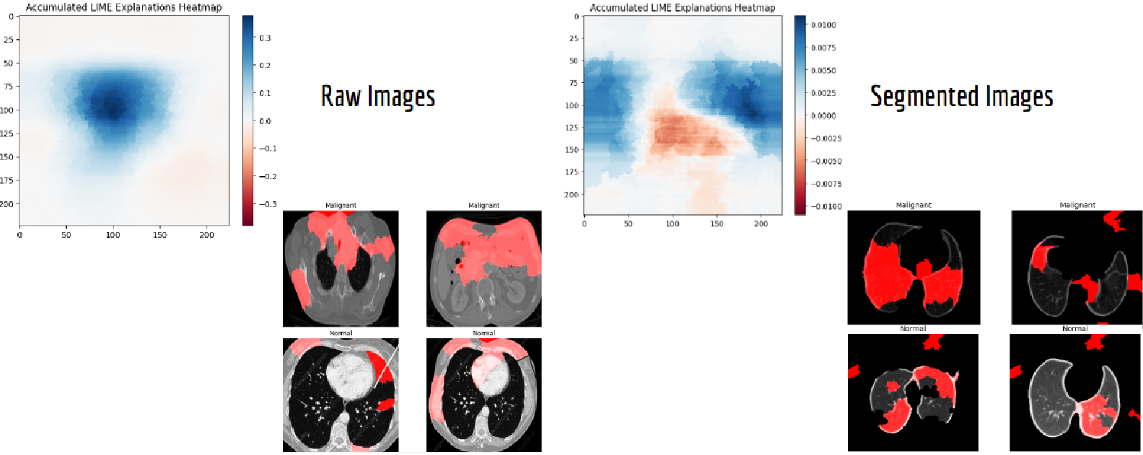
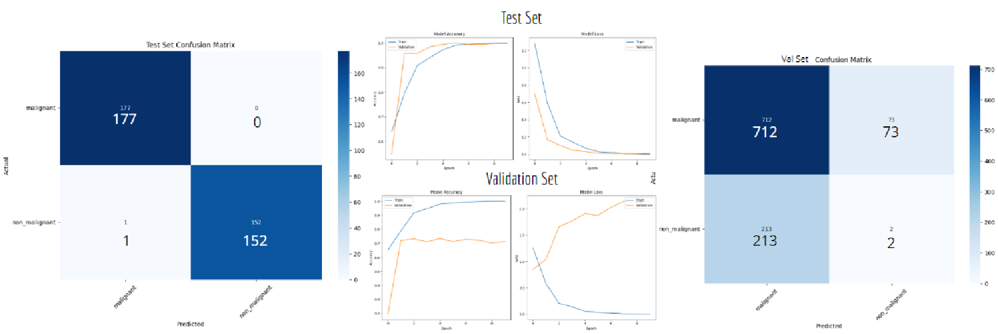
CNN Model
LIME HEATMAP
CNN CONFUSION MATRICES

Slide 26
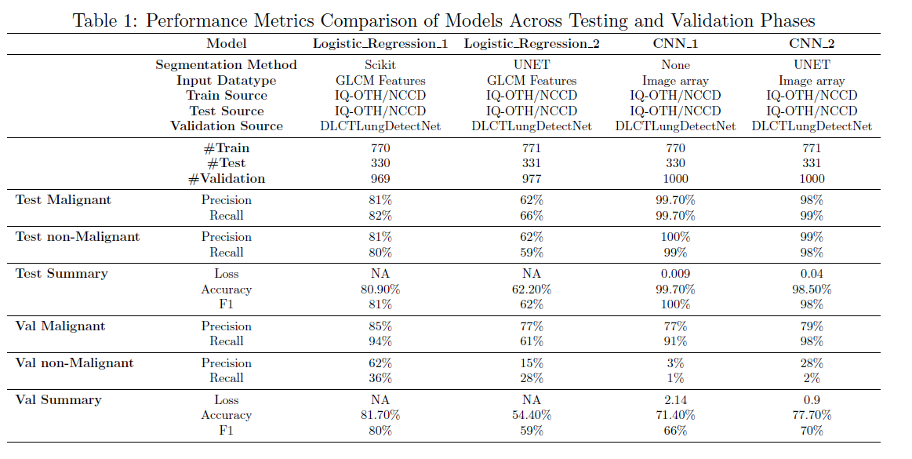
Result

